Slide 1


MSc Team Project An introduction

Slide 2
Module Aim
To provide the students with the opportunity to undertake a significant software development project from initial concept stage right through to delivery and evaluation stage in a team environment that closely represents the project environment in industry.

Slide 3
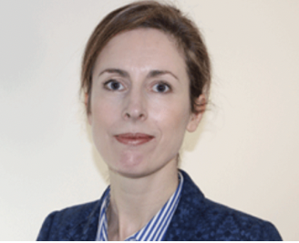
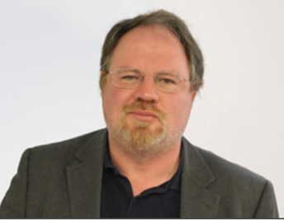
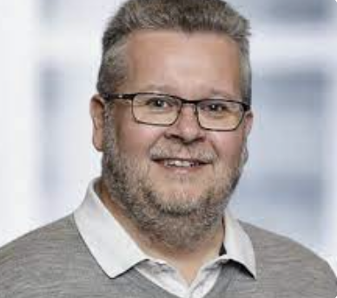
Staff involved
Module Coordinator:
Andrea Curley – andrea.f.curley@tudublin.ie
Coordinators:
Damian Gordon – damian.x.gordon@tudublin.ie
Brendan Tierney - brendan.tierney@tudublin.ie

Slide 4
Some Module Specifics
The contact hours are 2 hours per week which are delivered irregularly over the semester with more contact hours at the start.
The module is worth 30 ECTS.
The module is 100% CA.
Each student should spend approx. 40 hours per week working on the project.

Slide 5
Some Module Specifics
Classes are mainly onsite
There will be the three mentors at all classes
All groups will interact with all mentors
Individual groups will present to the mentors and other groups

Slide 6
What does the team do?
Design, implement, test & evaluate a software system
Use code/collaboration platform
Receive lectures
Team
Do show-and-tells
Receive feedback
Submit reports
Make presentations
Do software demos

Slide 7
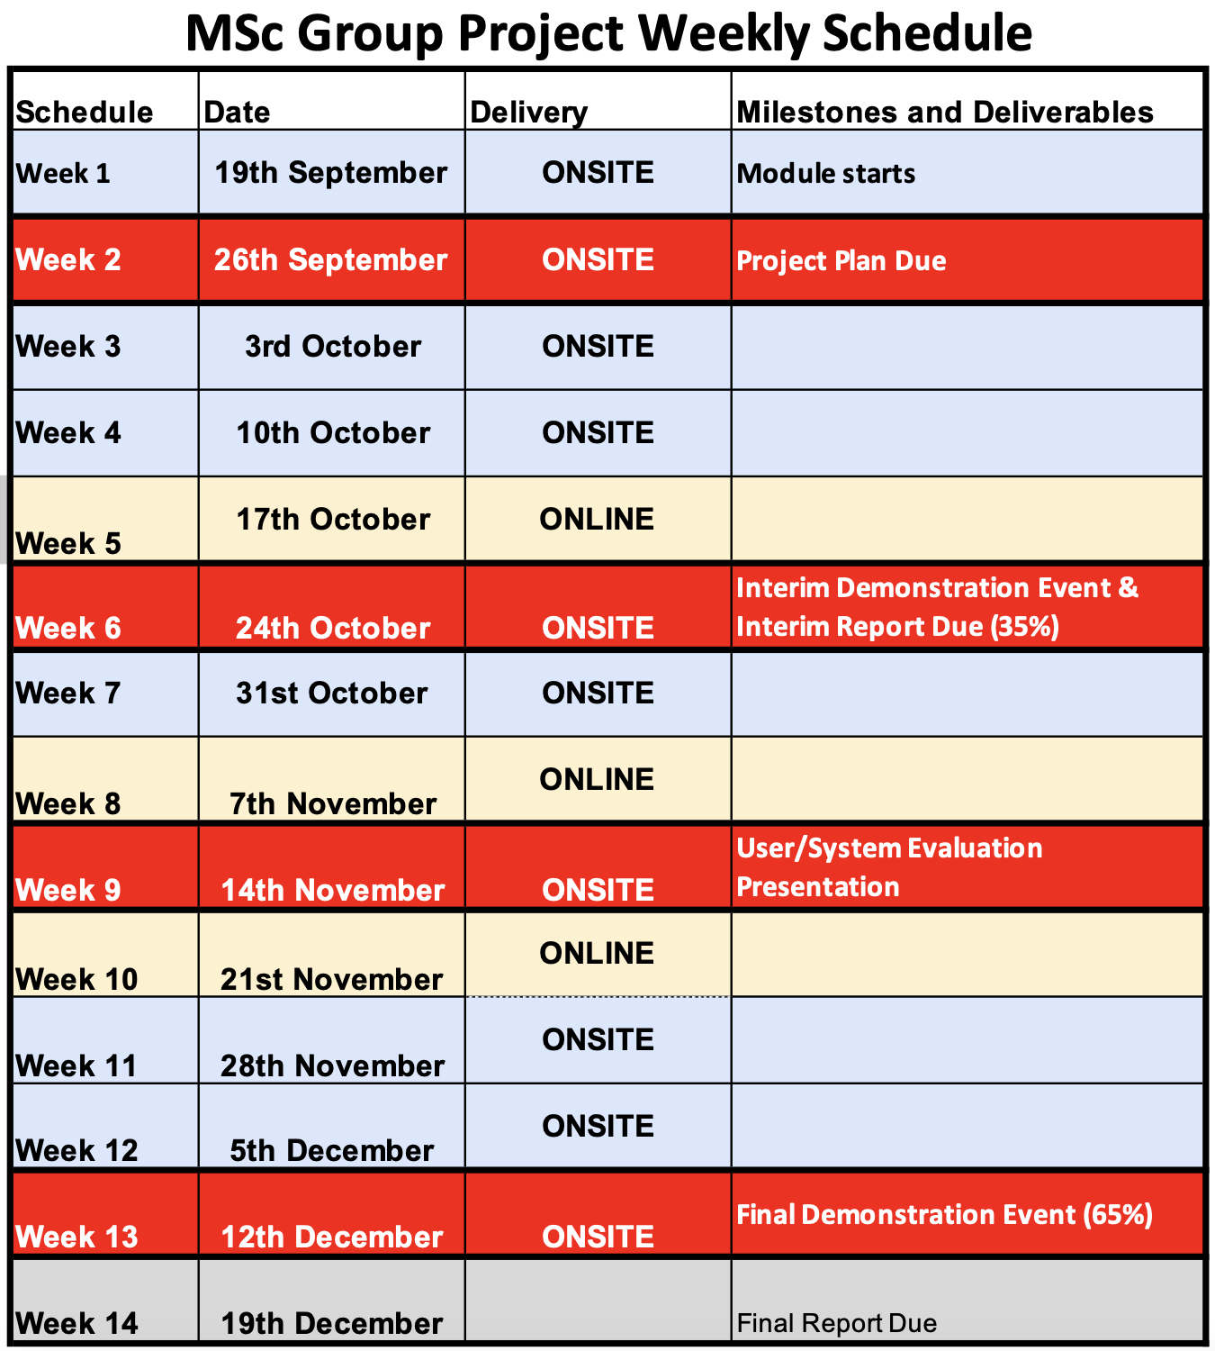

Slide 8
Assessment
Team assessment:
35% for the Interim Presentation/Demo & Report
60% for Report
10% for Demo
30% for Presentation
15% for the Final Presentation & Software Demo
50% for the Final Report

Slide 9
Assessment
Individual assessment:
Individual Diary
To be submitted on Weeks 4, 8 and with final submission.
Individual’s Contribution which includes:
Attendance
individual contribution at the show-and-tell sessions (both on-site and video)
individual contributions to the Team Repository

Slide 10
Assessment
Each group member inherits the overall Team Assessment mark.
This mark is then influenced by their Individual Assessment.
An individual’s mark will be scaled in accordance with their individual contribution in cases where team members show significant discrepancy in contribution across the module.

Slide 11
Assessment
Team assessment (80%)
(influenced by individual contribution)
+
Individual assessment(20%)

Slide 12
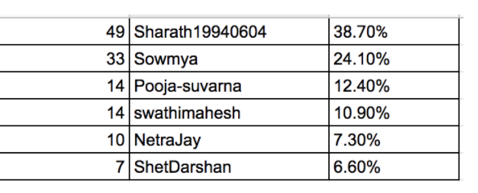
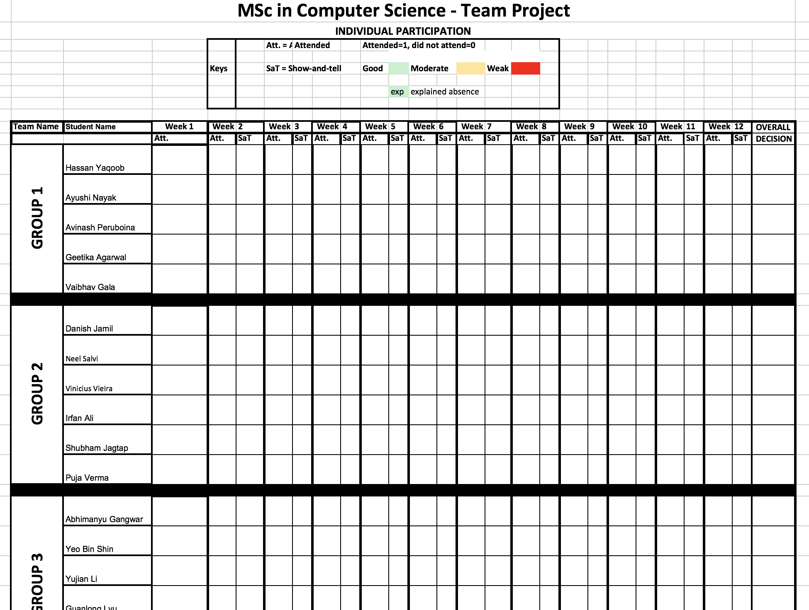
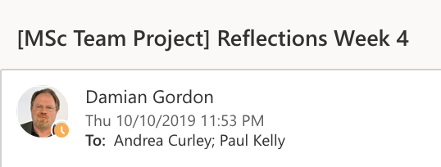
Individual Contribution
We track Github & Zenhub contributions weekly
We track attendance and contribution in class
We record reflections from each class

Slide 13
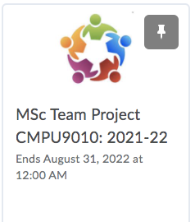
What are we using to deliver this?
Lectures
Marking Sheets
Templates
Any other relevant material

Slide 14
Week 2: Project Plan
This forms a contract between the team and the Module Coordinators and should include:
a summary of the project and the software deliverable
the main use-cases
outline of the user evaluation
plan for project management, team roles and team meetings.

Slide 15
Week 2: Project Plan
Each team should identify team members that are responsible for:
project management
software development
user experience and evaluation
communications, i.e. the deliverables the demos and presentations and the reports to be submitted.
Each team should identify their regular meeting schedule.

Slide 16
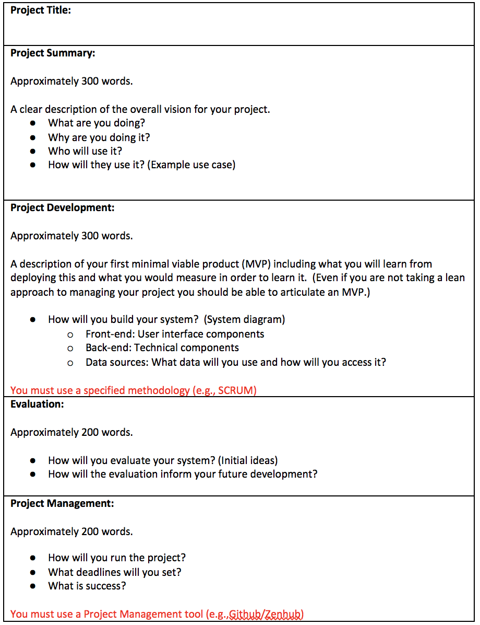
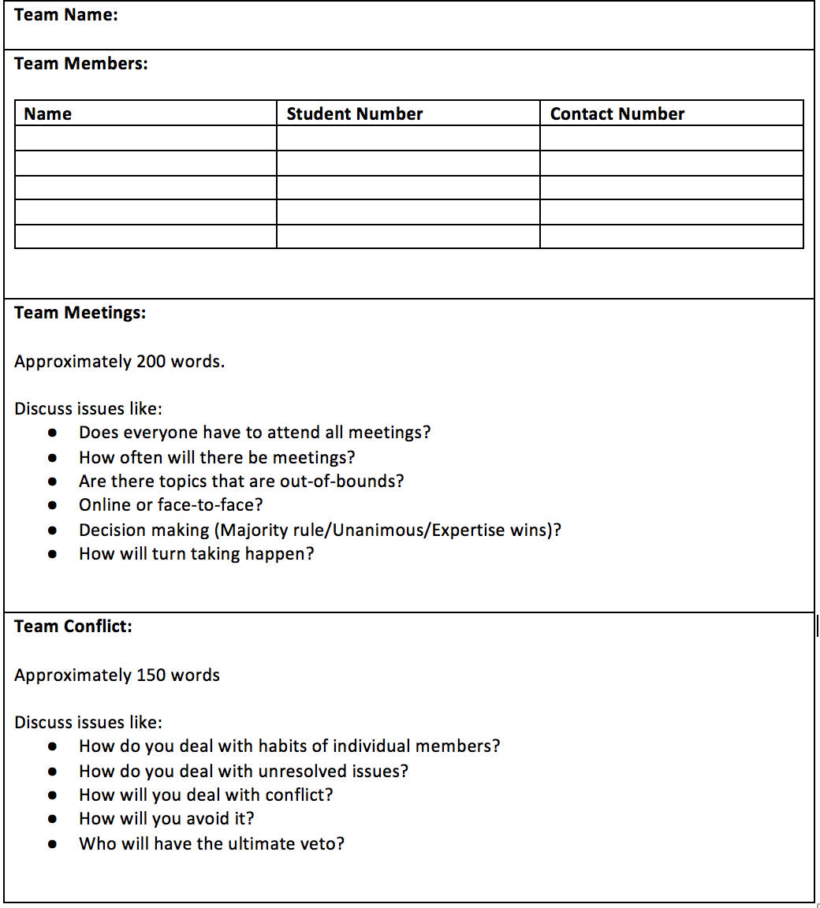
Week 2: Project Plan

Slide 17
What is a good project?

Slide 18
Characteristics of Strong Projects
Solving Technical Challenges: Complex technical components, original, high-quality solutions (beyond simply scraping the data, e.g., scale of data processed, high accuracy, efficiency, reactivity and usability of the system)
Satisfying User Needs: Evaluated the quality of the solution using real users, other teams’ feedback, peer feedback or external feedback from stakeholders relevant to the project (e.g., news editors, lawyers)
Familiarity with State-of-Art: Surveyed the state-of-the-art to find existing solutions, clearly described the related work (referencing relevant literature) and explained what the project brings to the table, and why the contribution is significant.
Communicating Excellently: Excelled in delivering and communicating the technical aspects, as well providing detailed and comprehensive analysis on other aspects (e.g., user evaluation, team management, lessons learned).

Slide 19
Is your project feasible?

Slide 20
Projects Feasibility Checklist
Data Feasibility: Is all of the data required for your project publicly and freely available? If not, how are you going to acquire that data?
Technical Feasibility: Do you believe that you will have access to the necessary skills and software/hardware resources to implement your project?
Evaluation Feasibility: Do you believe you will be able to evaluate how well your final system works and meets your original goals? For example, will you be able to run a study which will allow real users to test your system?
Ethical Feasibility: Is your project ethical and legal? Are there any privacy implications involved in using the data that is required for your project?

Slide 21
The Team:

Slide 22
Consider team tools
Consider any of the following:
Creating a FACEBOOK GROUP
Setting up a GOOGLE DRIVE
Setting up a shared DROPBOX
Setting up a ONENOTE instance

Slide 23
Mandatory team tools
Set up GITHUB
Send Andrea, Damian & Brendan the repository link
Set up Project Management tool (e.g.ZENHUB)
ALL STUDENTS SHOULD HAVE DONE THE PRE-MATERIAL ON THESE AREAS

Slide 24
Roles
When assigning roles, remember that it is not that the person with that role has to do all the work in that area, everyone in the team must contribute to each of the roles, but the person who is named in a particular role is the one who has final sign-off in that area.

Slide 25
Requirements Gathering:

Slide 26
Investigating Similar Applications
Look for a few different examples.
Not just looking at the homepage, looking at the pages within
Highlight what is good about the application, and what can be used as inspiration
Look at what they thought wasn’t good about the application, and look at ways they could improve on it.

Slide 27
Planning:

Slide 28
Plan
Have a clear plan.
Divide it into clear stages
Provide detail on each stage

Slide 29
Milestones
Create a timeline:
WEEK 1
We will be looking
at…
WEEK 3
We will be looking
at…
WEEK 5
We will be looking
at…
WEEK 7
We will be looking
at…
WEEK 2
We will be looking
at…
WEEK 4
We will be looking
at…
WEEK 6
We will be looking
at…
WEEK 8
We will be looking
at…

Slide 30
System Development:

Slide 31
Software Methodology
Select a methodology that suits the team:
Test-Driven Development
Feature-Driven Development
User-Centred Development
Agile
XP
SCRUM
DSDM

Slide 32
Technical Architecture
Create a technical architecture diagram:

Slide 33
Interface Considerations
Universal Design
Usability
Accessibility
Friendly
Portability
Configurable
Minimum number of clicks

Slide 34
Evaluation Considerations
Identify the end-user
Are there suitable users to evaluate your system?
List the evaluation criteria
What methods/techniques are you going to use to evaluate the system?

Slide 35
Provide a good summary
WHAT WE KNOW
A range of different languages
What project we are doing
They we will all code
What programming environment we are using
What programming language we are using
WHAT WE DON’T KNOW
Each other’s skills
A full functional specification
A clear test plan
What the security consideration are
What are secondary and what are primary features

Slide 36
Presenting the Project Plan - PowerPoint
Make the PowerPoint look appealing
Included lots of images
Put in a lot of text explaining what they are doing

Slide 37
What do you need to submit next week?
Each group must submit a project proposal (template is available on Brightspace) on Thursday 25th @ 10am. Late submissions will affect your grade.
Each group must submit one video with a 1-minute show-and-tell from EACH student on what they have done for the week. This needs to be submitted each week on Wednesday @ 6pm.

Slide 38
Plagiarism
Plagiarism is a very serious offence
Please read the General Assessment Regulations pertaining to plagiarism - https://www.tudublin.ie/media/website/explore/about-the-university/academic-affairs/assessment-/TU-Dublin-Assessment-Regulations-for-Taught-Programmes-(Published-August-2025).pdf

Slide 39
A final thought.. Once you have your project plan done, you need to start thinking about who are the end-users..

Slide 40
Who are your users?
You need to research who are your user group – age, demographic, technical experience…
You need to interact with your user group:
Interviews
Surveys
….
You need to be informed on what are the needs of your user group

Slide 41
Who are your users?
You will interact with your user group several times throughout the project, to test and evaluate your designs.
You need to start this now!

